Slide 1
ENHANCING CYBERSECURITY IN ACS DEPARTMENT
RESEARCH PROJECT
PRESENTED BY VI LE

Slide 2

BACKGROUND
“44% increase in cyberattack since 2022” -Checkpoint Blog
2200 cyberattacks every day according to research in 2017
28778 new vulnerabilities was discovered in 2023, an increase of more than 3000 compared to 2022 according to CVE
A recent cyberattack at the University of Winnipeg occurred on March 24, 2024

Slide 3
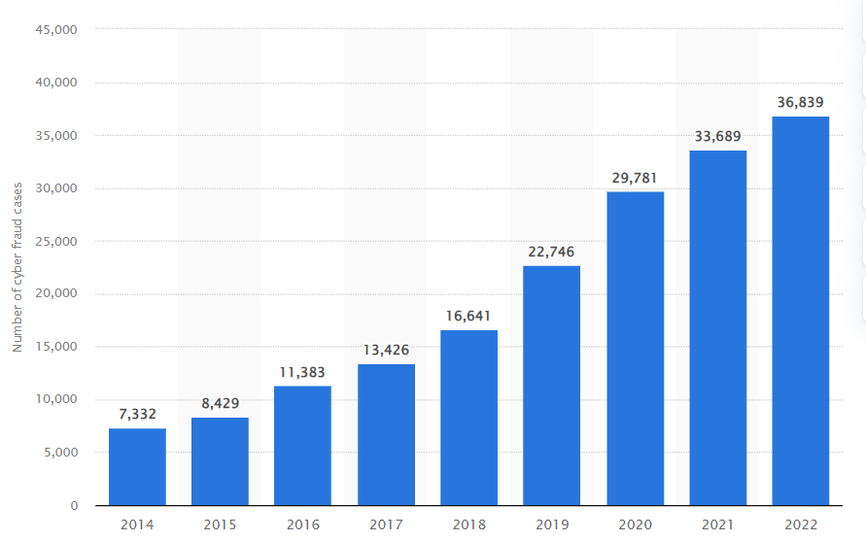
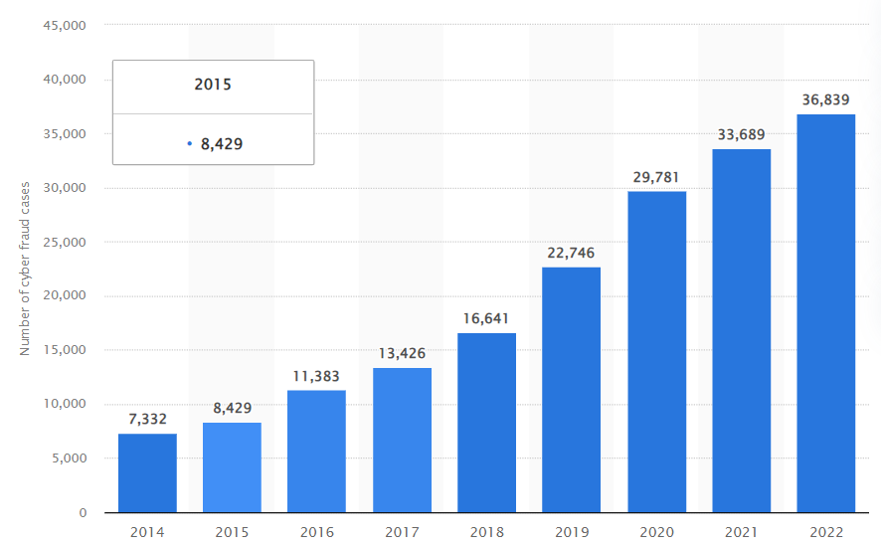
Number of police-reported instances of internet fraud in Canada from 2014 to 2022

Slide 4
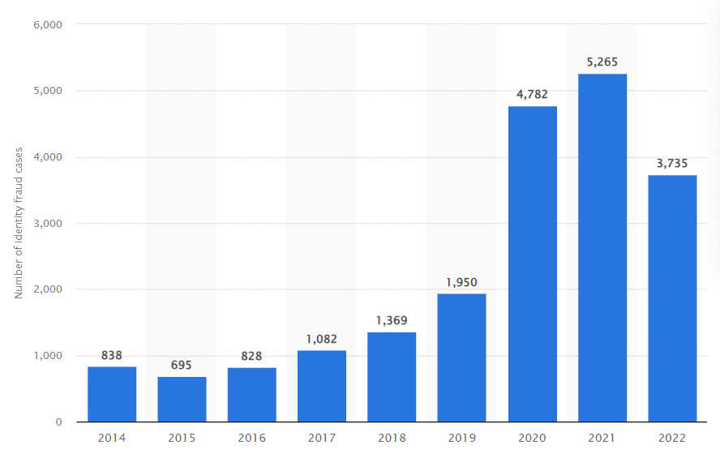
Number of police-reported instances of online identity fraud in Canada from 2014 to 2022

Slide 5
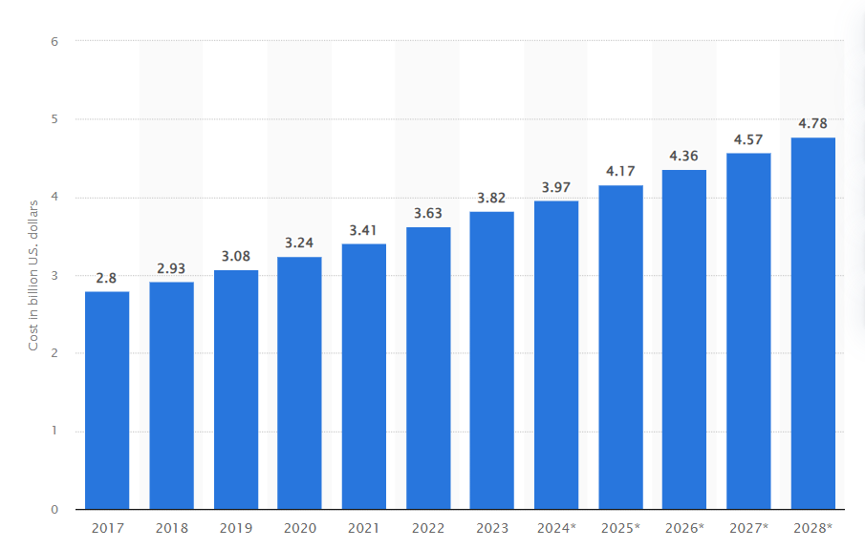
Estimated annual cost of cybercrime in Canada from 2017 to 2028

Slide 6

OBJECTIVES
1 Investigate past cyber attacks within ACS department.
2 Analyze attack methods, attack surfaces, and damage caused due to those past attacks.
3 Review current systems, critical assets, and architectural design of ACS department
4 Evaluate current protocols, and security policies of ACS department
5 Evaluate the effectiveness of current control mechanisms, defensive measures implemented in ACS department’s system.
6 Conduct risk analysis and propose strategies to mitigate those risks.
7 Design an incident response plan for ACS department.
8 Design penetration testing plan for ACS department

Slide 7
SCOPE OF RESERACH
ACS Physical Security
ACS
TECHNOLOGY SOLUTION CENTER
Systems and Networks
Policies and Guidelines
Human Factor

Slide 8




CHALLENGES UNIQUE TO ACADEMIC SETTING
1.
Limited Academic Literatures about Subject
2.
Culture of Openess
3.
Decentralized Systems
4.
Bring Your Own Device Policy
5.
IoT Adoption

Slide 9
METHOLOGY
1.
Conduct Interviews
2.
Do Interview Analysis
3.
Create High-level network diagram of ACS
4.
Conduct Threat Modeling
5.
Risk Evaluation

Slide 10

PARTICIPANTS
Students
Faculty member
Administrator/
Technician
A member of Information Security Managment

Slide 11

INTERVIEW QUESTION SETS
Students
Faculty member
Administrator/
Technician
A member of Information Security Managment

Slide 12
INTERVIEW PROCESS
Invite participant
Coordinate time and place for interview
Sign Consent form
Ask Permission for Audio Recording
Start Interview

Slide 13


INTERVIEW ANALYSIS
Quantitative Data
Qualitative Data

Slide 14
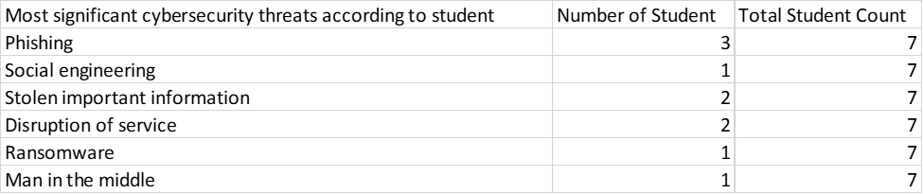
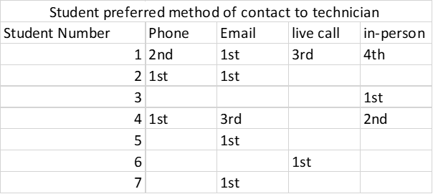
SOME QUANTITATIVE DATA

Slide 15
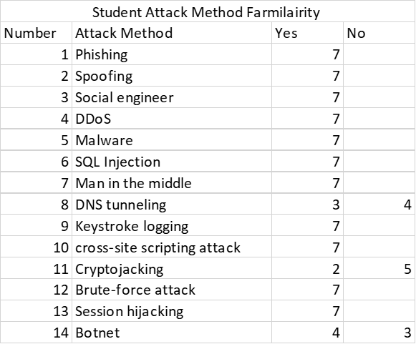
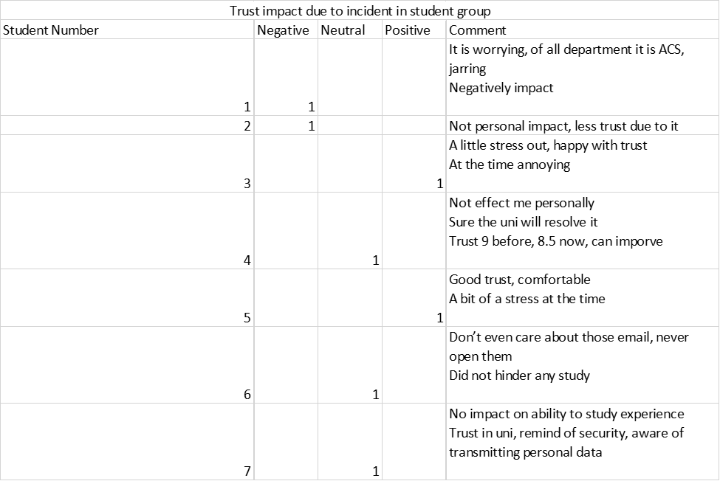
SOME QUANTITATIVE DATA

Slide 16
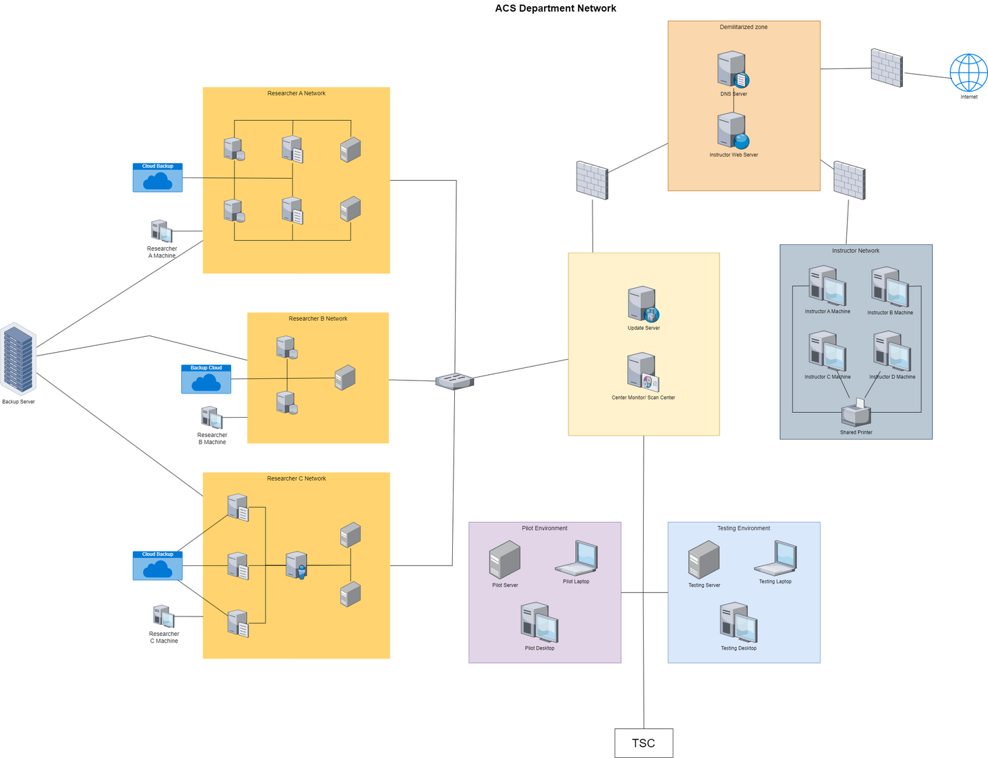
HIGH LEVEL NETWORK DIAGRAM

Slide 17
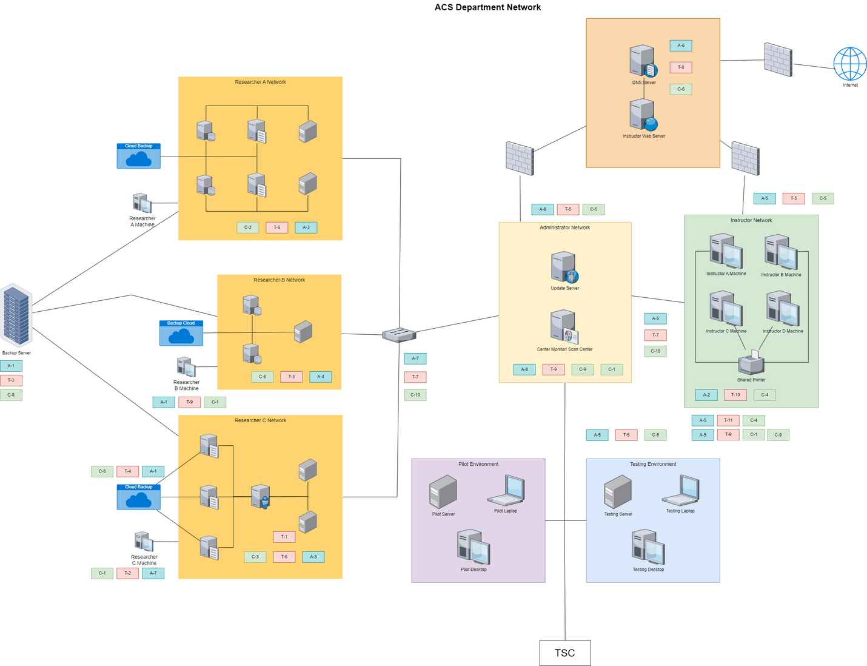
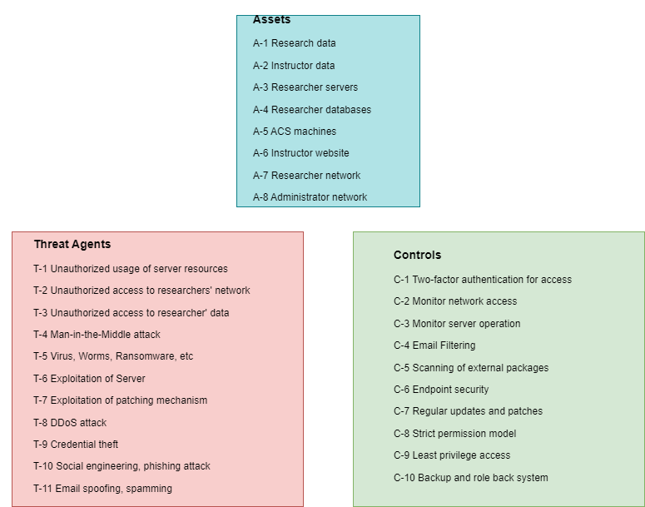
THREAT MODEL DIAGRAM

Slide 18
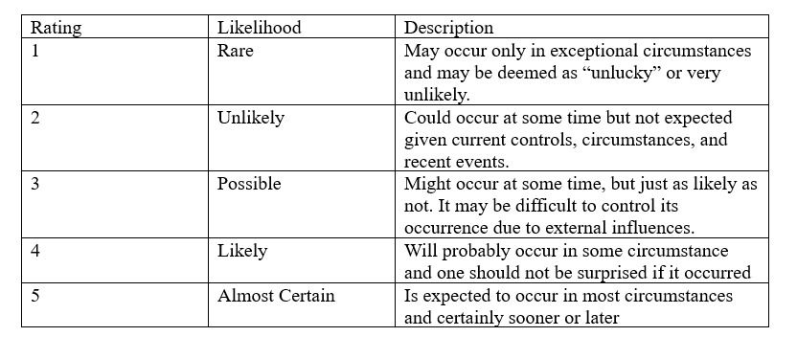
THREAT EVALUATION
LIKELIHOOD TABLE

Slide 19
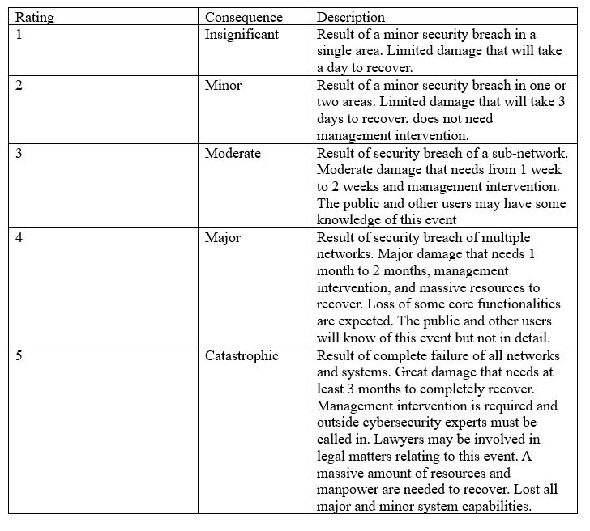
THREAT EVALUATION
CONSEQUENCES TABLE

Slide 20
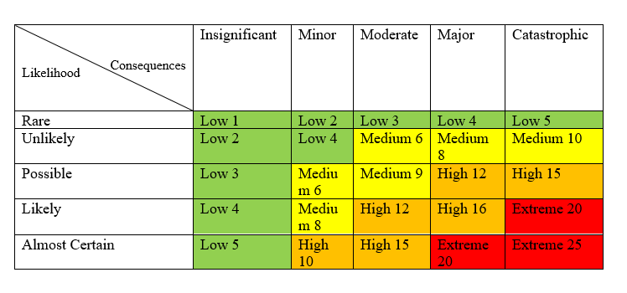
THREAT EVALUATION
RISK MATRIX

Slide 21
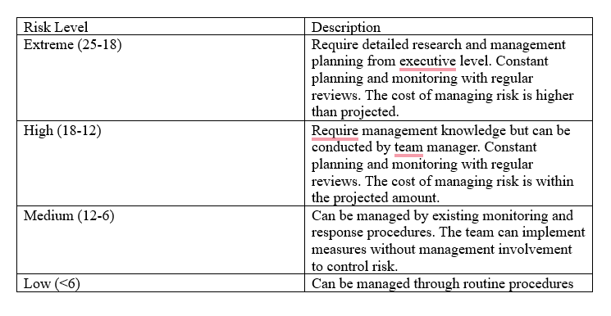
THREAT EVALUATION
RISK LEVEL TABLE

Slide 22
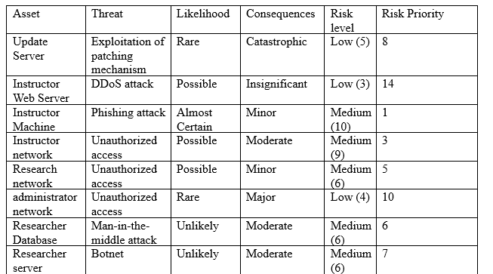
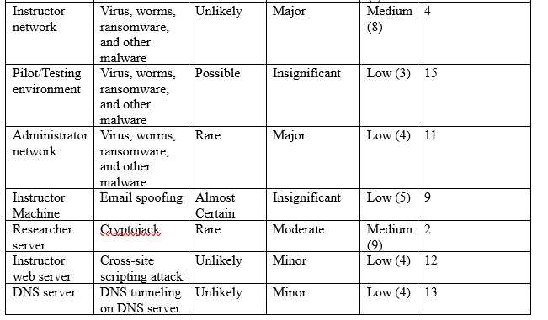
THREAT EVALUATION
RISK REGISTRY

Slide 23




IDENTIFIED VULNERABILITIES AND RISKS
ADVANDED PERSISTANT THREAT
ZERO-DAY VUNERBILITIES
PHYSICAL SECURITY
RESOURCE CONSTRAINT

Slide 24



IDENTIFIED VULNERABILITIES AND RISKS
INSIDER THREAT
OUTSIDE THREAT
FILELESS MALWARE
PHISHING ATTACK

Slide 25




IDENTIFIED VULNERABILITIES AND RISKS
POLICIES
UPDATE PROCESS
ACCESS AND PRIVILEGE CONTROL
COMMUNICATION

Slide 26







RECOMMENDATIONS
MOVE SHARED PRINTER
FINGER-PRINT LOCKS
HIRE MORE PERSONNEL
NO EDUROAM
LIMITED INTERNET
VIRTUAL MACHINE
PHISHING AWARENESS

Slide 27
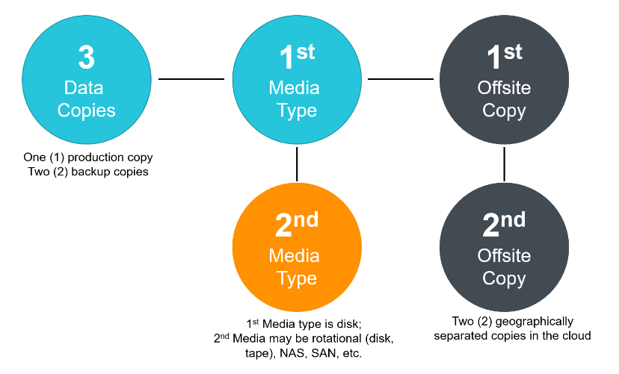
RECOMMENDATIONS
3-2-2 BACKUP SYSTEM

Slide 28
RECOMMENDATIONS
INCIDENT RESPONSE PLAN
1.
Inform the department chair and TSC cybersecurity team about the incident
2.
Compile as much relevant information as possible while waiting for a response from the Technology Solution Center cybersecurity team
3.
Limit spread of damage, if multiple systems compromised then isolate affected network

Slide 29
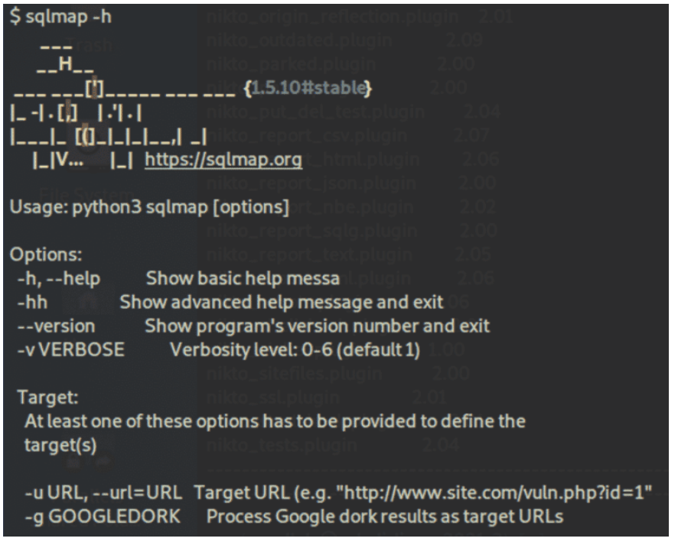

RECOMMENDATIONS
PENETRATION TESTING TOOL

Slide 30

THANK YOU FOR LISTENING
ANY QUESTIONS? ASK AWAY
PRESENTED BY VI LE

